Slide 1
Using the Modes Page in the Skydance App

Slide 2
This is the first page you will see when you enter the skydance app.

Slide 3
Click anywhere on this bar to begin customizing your lights.

Slide 4
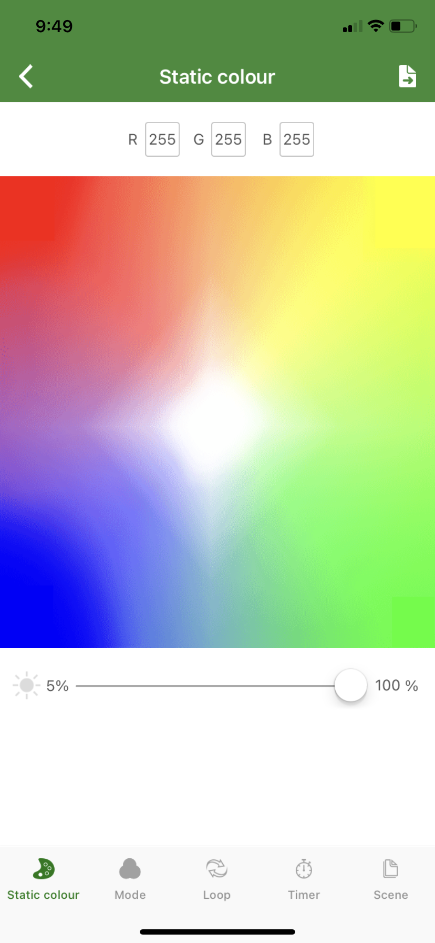
Doing this will take you to the “Static colour” page.

Slide 5
Click on the “Mode” icon on the bottom toggle bar.

Slide 6
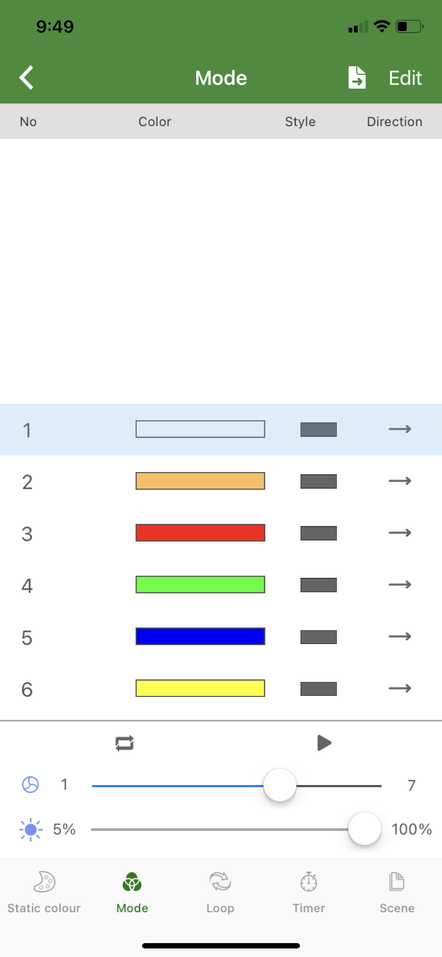
Now you are on the “Mode” page.
There are 32 preset modes that you can choose from on this page.

Slide 7
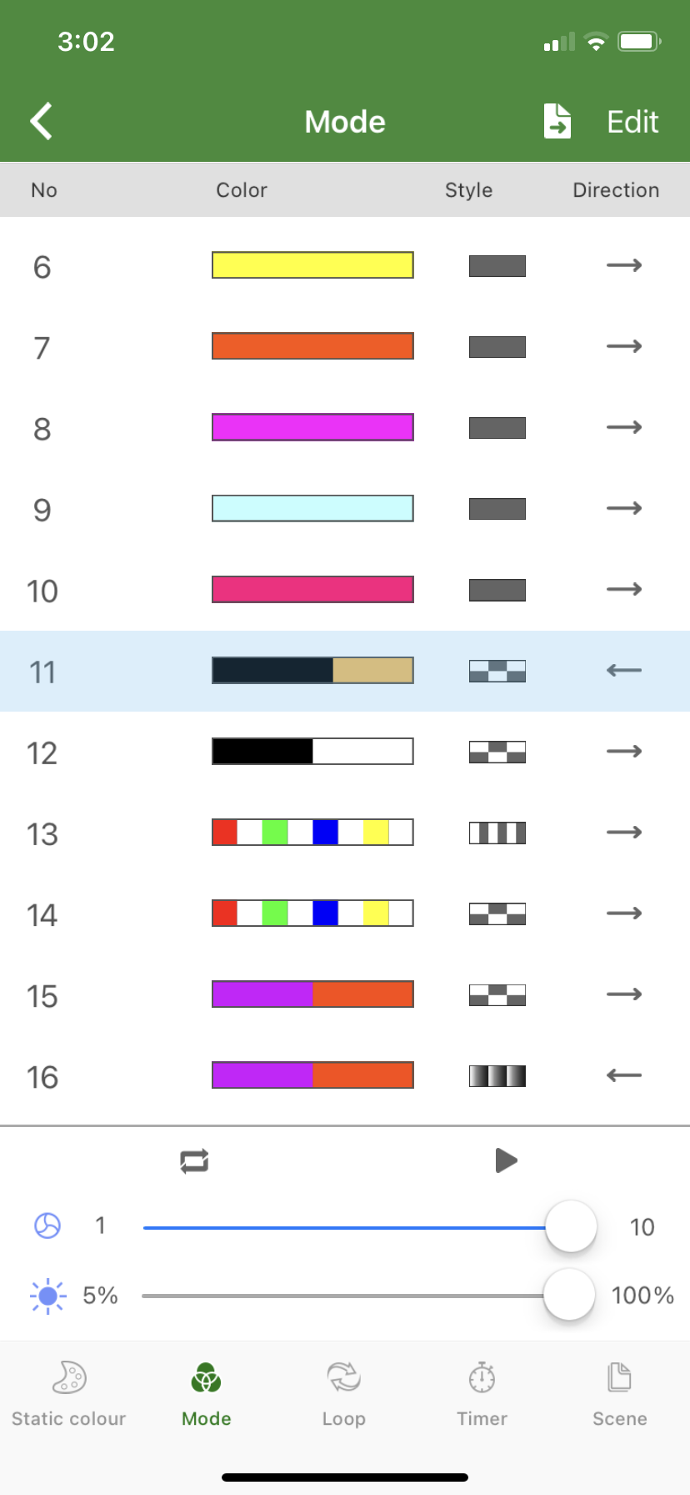
First, select a mode that you want displayed on your house. We chose mode 11.

Slide 8
Now you can set your desired speed and brightness of the mode using these sliders.

Slide 9
We set our speed to 3, and our brightness to 70%. If you want your effect to stop moving completely you can click here to pause it.

