Slide 1
Setting Timers in the Skydance App

Slide 2
This is the first page you will see when you enter the skydance app.

Slide 3
Click anywhere on this bar to begin customizing your lights.

Slide 4
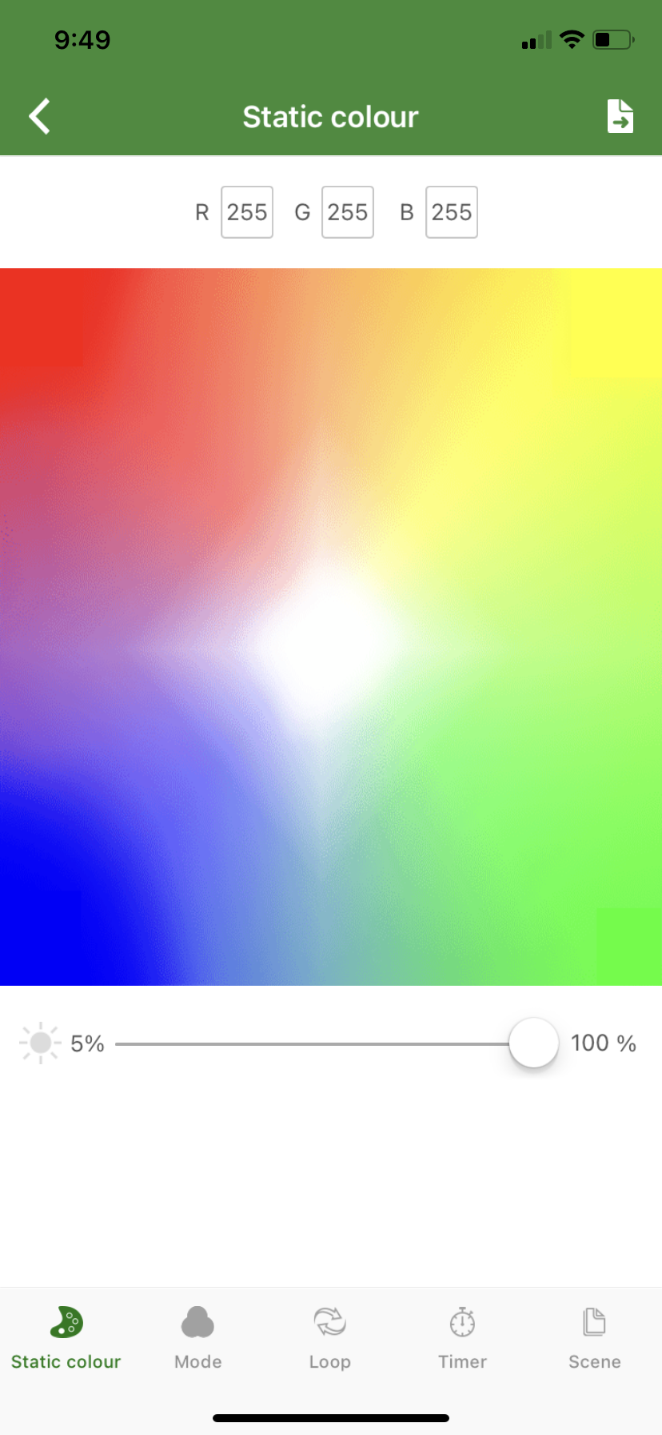
Doing this will take you to the “Static colour” page.

Slide 5
Click on the “Timer” icon on the bottom toggle bar.

Slide 6
You are now on the “Timer” page.

Slide 7
Use these buttons to add or subtract timers.

Slide 8
The first thing to edit when setting a timer is the time that you want your lights to come on and turn off. Click here to edit this.

Slide 9
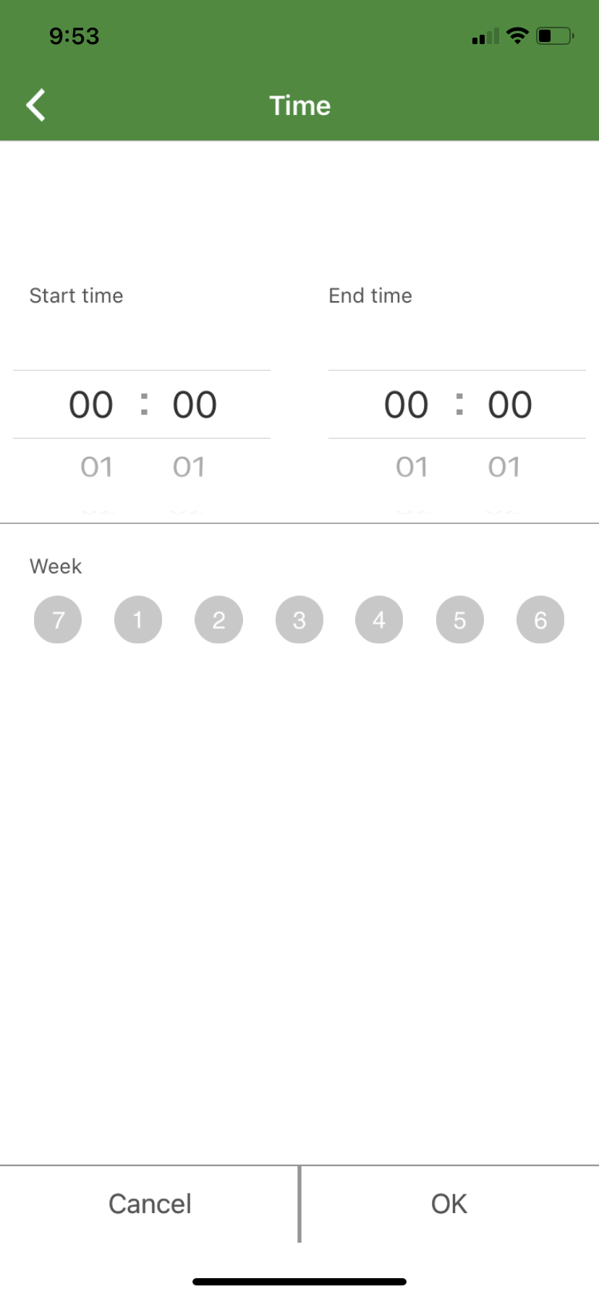
This will take you the “time” page. Here you will set start times, end times, and days of the week that you want the timer active for.

Slide 10
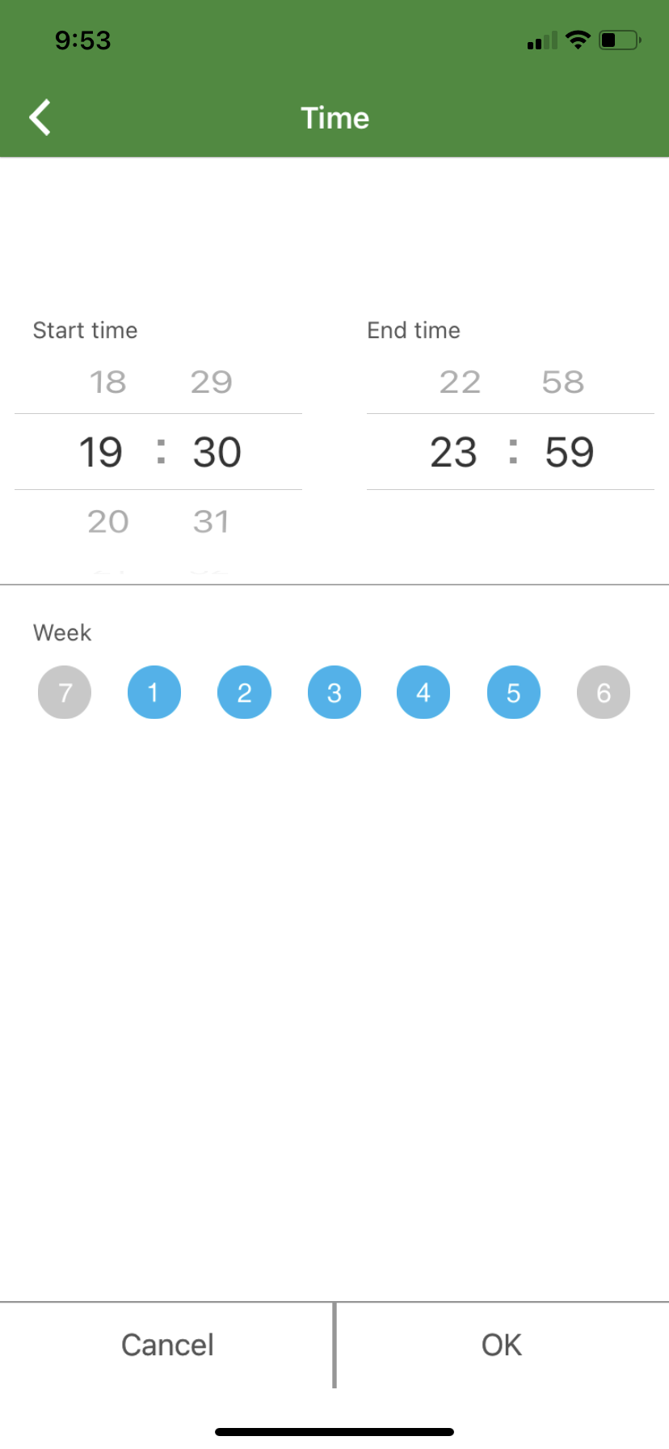
Make the changes that you want and click “OK”.
This timer is set to come on at 7:30pm, and go off at 11:59pm. It will do this from Monday to Friday.

Slide 11
The second thing to edit when setting a timer is the mode or effect that you want the timer to display. To do this click on this bar.

Slide 12
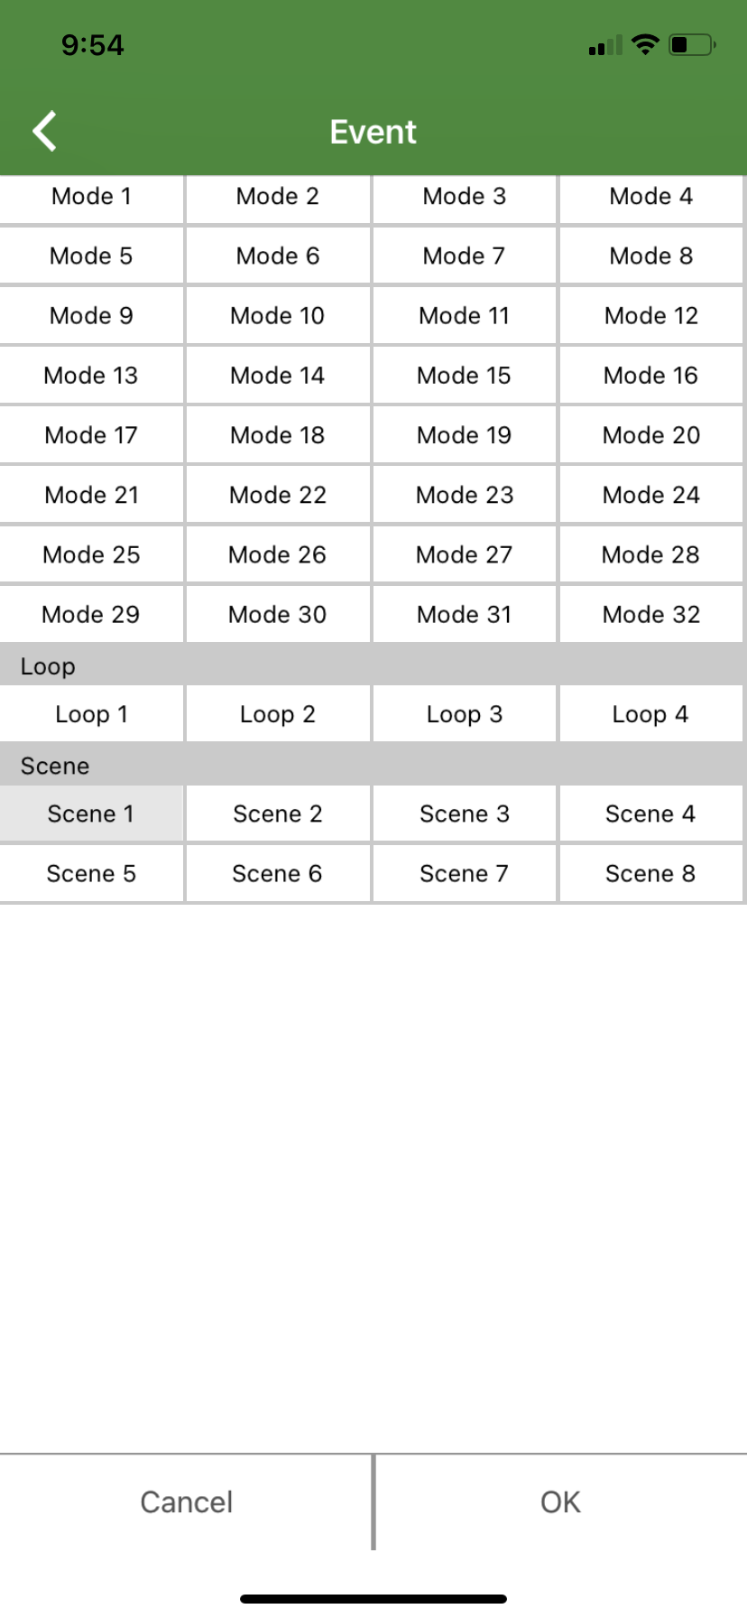
You will be taken to this screen where you can select any mode, loop or scene. Chose one and then click “OK”.

Slide 13
Now click on this toggle to make sure that your timer is turned on.

Slide 14
Lastly, click on the “play” button to activate your timer.

Slide 15
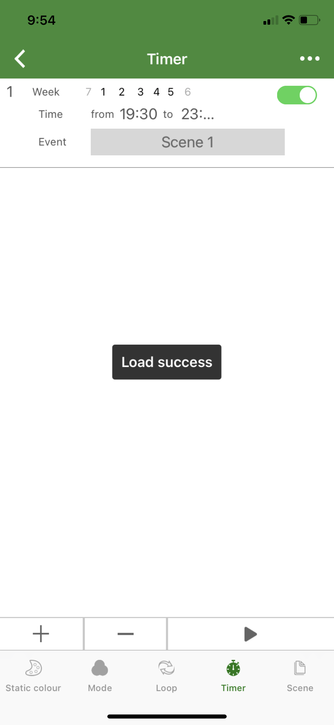
It should say “Load success”, if it doesn't then click the “play” button again. After it says “Load success” close out of the app. Clicking “play” should be the last thing you do in the app or your timers will not work.

